Slide 1
Object Detection Evaluation Metrics and Benchmarking

Slide 2

Follow up Contents
Evaluation Metrics
Precision
Recall
IOU
Precision x Recall Curve
Mean Average Precision (MAP)
Benchmarking and competition
Pascal VOC
COCO
ImageNet
Perquisite
Accuracy and Confusion Matrix Interpretation

Slide 3
Evaluation Metrics : Precision and Recall
Actual
Actual
E.g.
Cancer Detection
0
1
0
1
TN | FN
FP | TP
20 | 30
10 | 40
0 : Cancer Negative
1 : Cancer Positive
0
0
Predicted
Predicted
1
1
70
30
N = TN + FP
P = TP + FN
30
70
TP
40
40
TP
TP
40
40
Precision =
=
=
Recall =
=
=
=
TP + FP
40 + 10
50
TP + FN
P
40 + 30
70

Slide 4
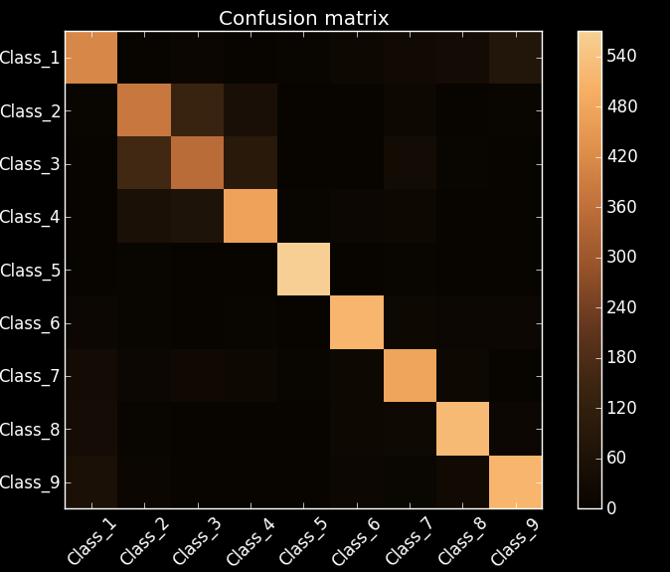
Evaluation Metrics : Precision and Recall – Multi Class
One VS Rest Approach
Actual
Actual
Rest cls
cls 1
Rest cls
cls k
Rest cls
TN | FN
FP | TP
TN | FN
FP | TP
Rest cls
Predicted
cls 1
cls k
Actual
0
1
2
TP | FP | FP
FN
FN
0
Predicted
1
2

Slide 5
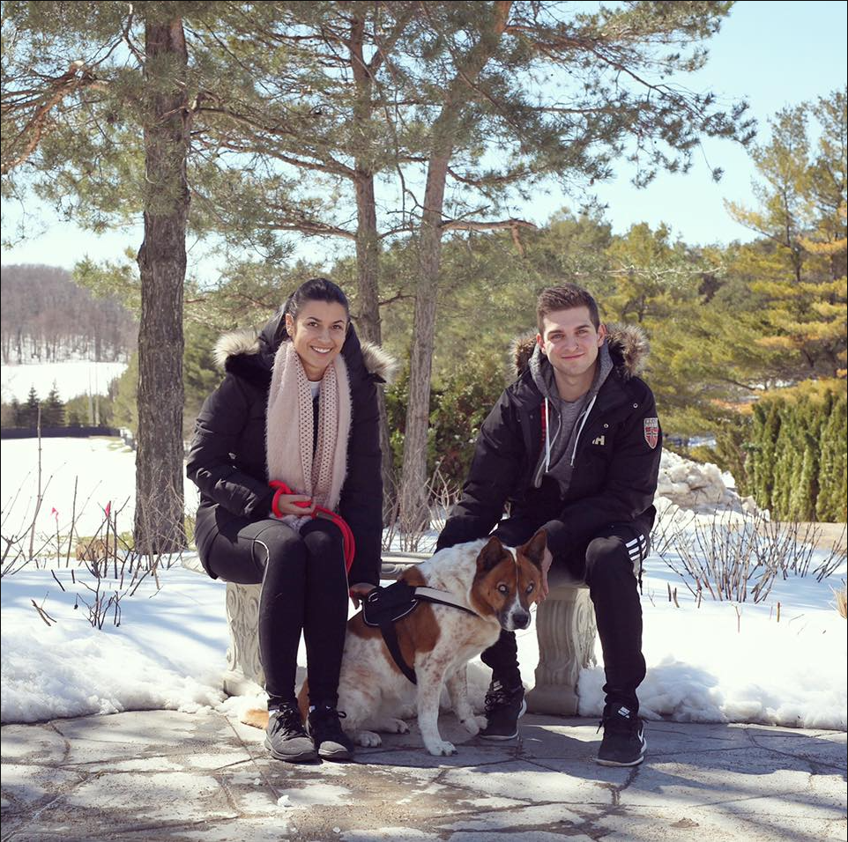
Evaluation Metrics : Object Detection
How to detect if Predicted Bounding Box is good or bad ?
Person
Person
DOG
Query Image with ground Truth

Slide 6
Evaluation Metrics : Object Detection
How to detect if Predicted Bounding Box is good or bad ?
Person
Person
Considering Only person Class
How to evaluate mathematically ?
Query Image with ground Truth

Slide 7
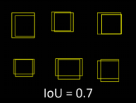
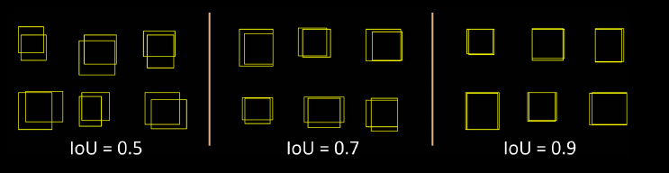
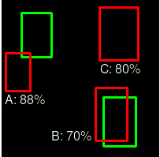
Evaluation Metrics : Object Detection - IOU
If IOU > = 0.7
TP
Else
FP
Ground Truth BBox
Predicted BBox
Intersection
IOU =
Union
A
B

Slide 8
Evaluation Metrics : Object Detection - IOU
If IOU > = 0.7
TP
Else
FP
False Positive
Person
Person
Considering Only person Class
True Positive
TP
TP
Precision =
=
TP + FP
All Positive Prediction by Model
Query Image with ground Truth
TP
TP
TP
Recall =
=
=
TP + FN
P
All Ground Truths
Credit: https://github.com/rafaelpadilla/Object-Detection-Metrics#precision-x-recall-curve

Slide 9
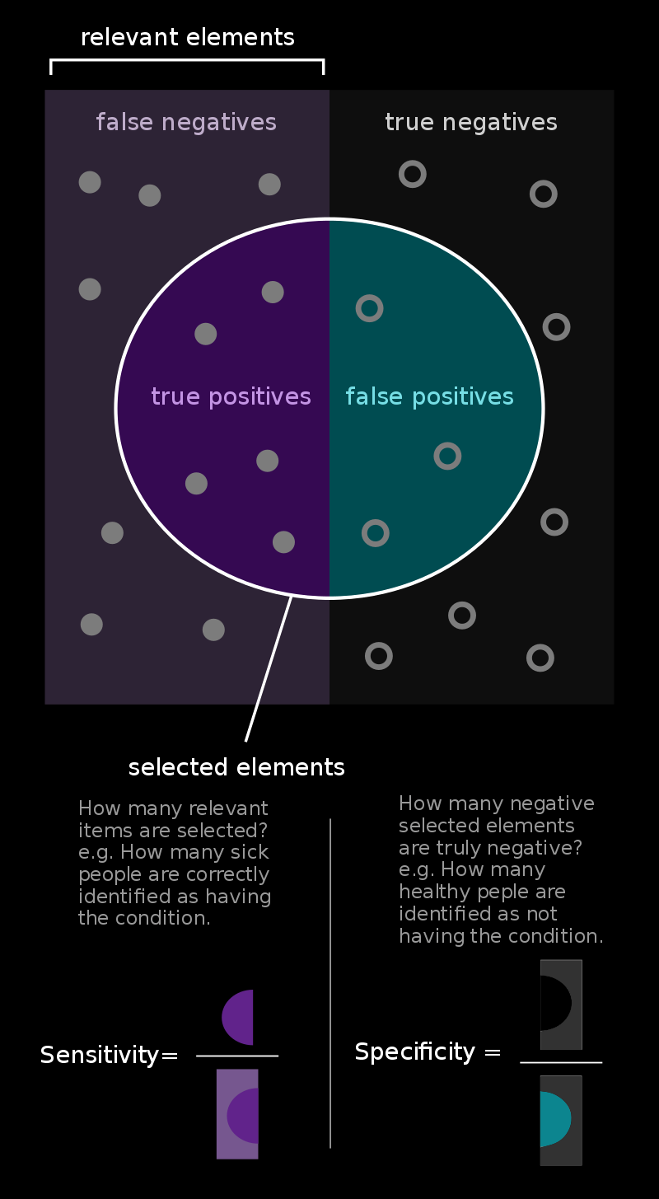
Evaluation Metrics : How to decide threshold value ?
Sensitivity and Specificity : TPR vs TNR
Sensitivity and Specificity Plot
Sensitivity
IOU = 0.7
Specificity
IOU
Sensitivity :
(TPR)
TP
TP
=
P
TP + FN
Ideally should be high sensitivity and high specificity.
At various IOU threshold calculate TPR and TNR.
Choose that IOU threshold which is giving balance b/w TPR and TNR.
TN
TN
Specificity :
(TNR)
=
N
TN + FP
Credit: https://en.wikipedia.org/wiki/Sensitivity_and_specificity

Slide 10
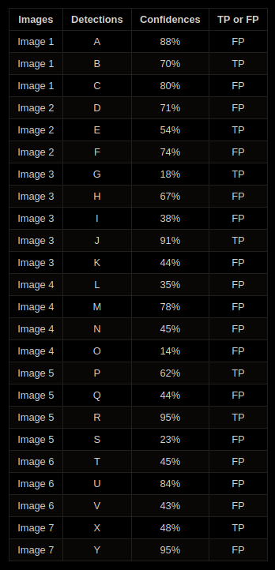
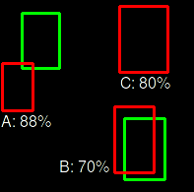
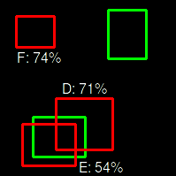
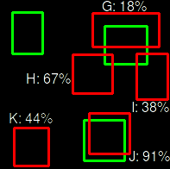
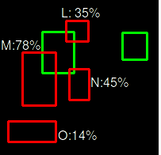
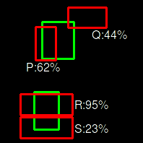
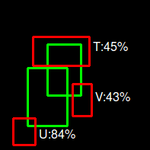
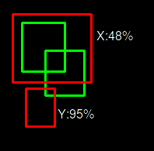
Evaluation Metrics : Object Detection – Precision x Recall Curve
Image 1
Image 2
Image 3
Image 4
Image 5
Image 6
Image 7
Credit: https://github.com/rafaelpadilla/Object-Detection-Metrics#precision-x-recall-curve

Slide 11
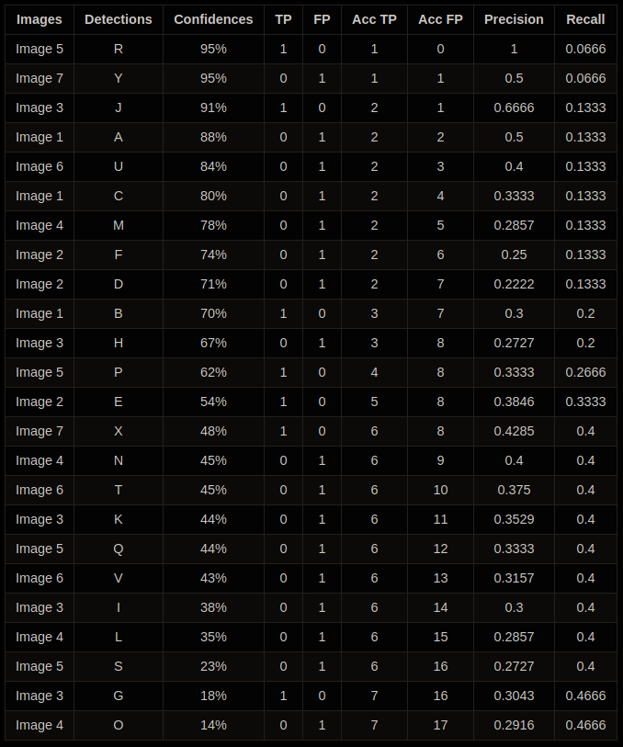
Evaluation Metrics : Object Detection – Precision x Recall Curve
Sort in decrease order of Confidence score
OHE of TP and FP
Calculate the accumulative TP and FP
Calculate Precision and Recall at each point
Credit: https://github.com/rafaelpadilla/Object-Detection-Metrics#precision-x-recall-curve

Slide 12
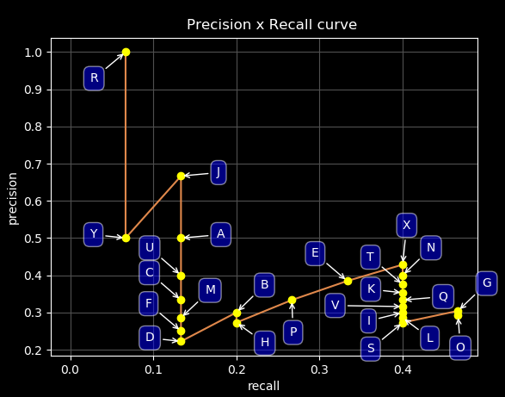
Evaluation Metrics : Object Detection – Precision x Recall Curve

Slide 13
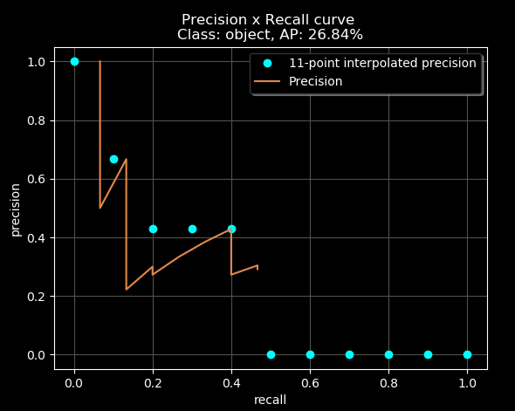
Evaluation Metrics : Object Detection – Precision x Recall Curve
11 Point Interpolation

Slide 14
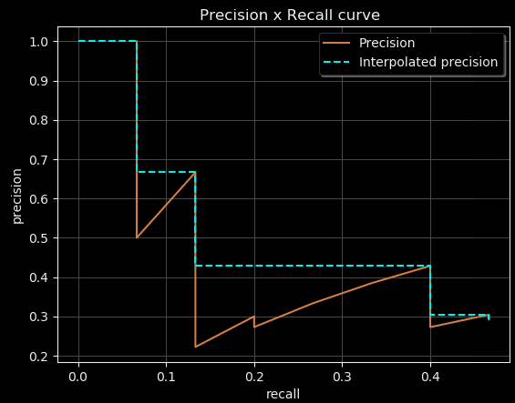
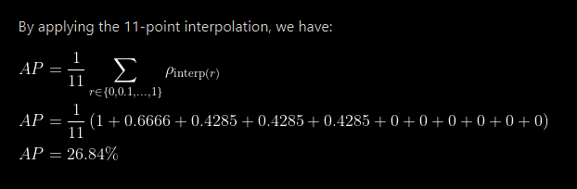
Evaluation Metrics : Object Detection – Precision x Recall Curve
11 Point Interpolation

Slide 15
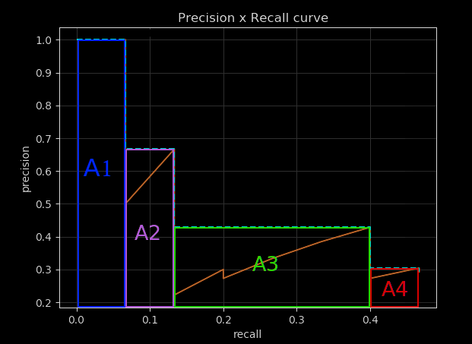
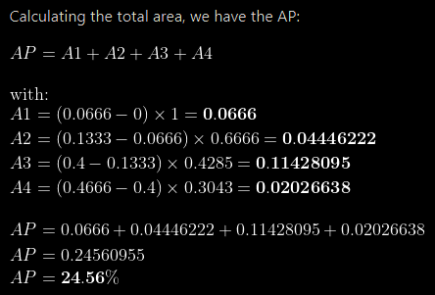
Evaluation Metrics : Object Detection – Precision x Recall Curve
ALL Point Interpolation
Credit: https://github.com/rafaelpadilla/Object-Detection-Metrics#precision-x-recall-curve

Slide 16
11 Point Interpolation
ALL Point Interpolation
Difference is very little.
Previously 11 point interpolation is used for Pascal 2007.
Changed it to All point interpolation method for pascal 2012.

Slide 17
Evaluation Metrics : Object Detection - MAP
Mean Average Precision (MAP)
Class 1 | Class 2 | Class 3 | Class 4 | Class 5 | Class 6
Cat | Dog | Person | Bike | Car | Bird
AP_{Cat} | AP_{Dog} | AP_{Person} | AP_{Bike} | AP_{Car} | AP_{Bird}
AP_{Cat} + AP_{Dog} + AP_{Person} + AP_{Bike} + AP_{Car} + AP_{Bird}
MAP =
Total # of classes

Slide 18
Evaluation Metrics
Precision
Recall
IOU
Precision x Recall Curve
Mean Average Precision (MAP)
Benchmarking and competition
Pascal VOC
COCO
ImageNet

Slide 19
Benchmarking and Competitions
Competitions
Dataset | Images | Classes
Pascal 2012 | 20 classes. The train/val data has 11,530 images containing 27,450 ROI annotated objects. | 21
COCO | The COCO train, validation, and test sets, containing more than 200,000 images and 80 object categories (with over 500,000 object instances segmented) | 80
ImageNet | 150,000 Images | 1000 / 200
Person
Person
DOG

Slide 20
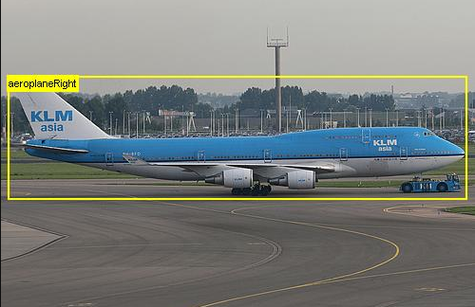
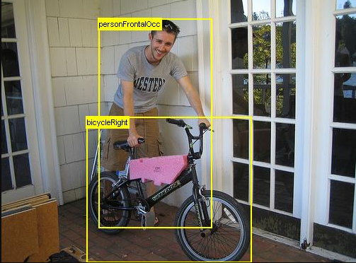
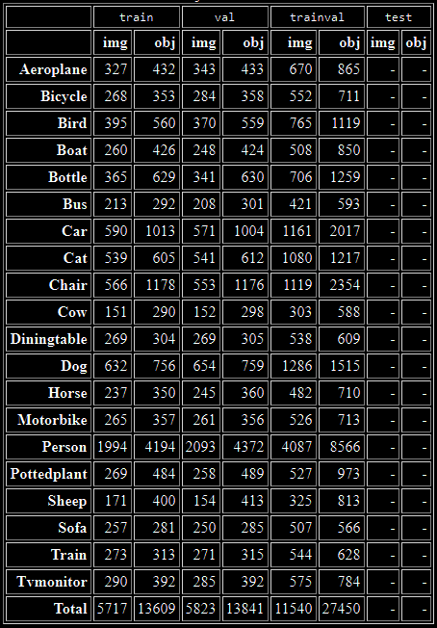
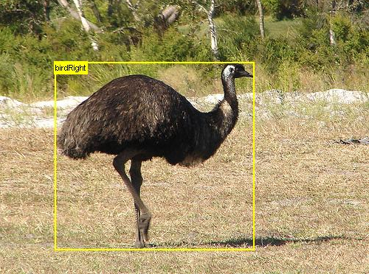
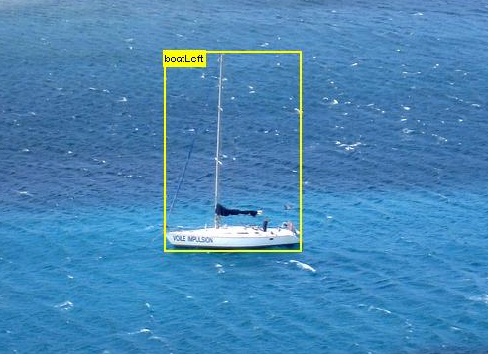
Benchmarking and Competitions
Competition
Pascal 2012
Aero planes
Bicycles
Birds
Boats
Bottles
Buses
Cars
Cats
Chairs
Cows
Dining tables
Dogs
Horses
Motorbikes
People
Potted plants
Sheep
Sofas
Trains
TV/Monitors
Aero planes
Bicycle
Bird
Boat
All images contain at least one instance of class

Slide 21
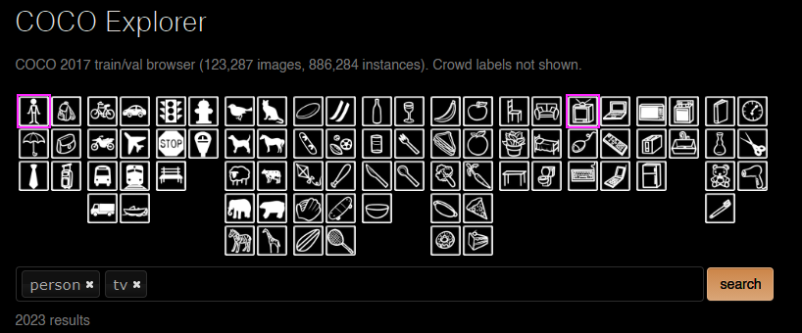

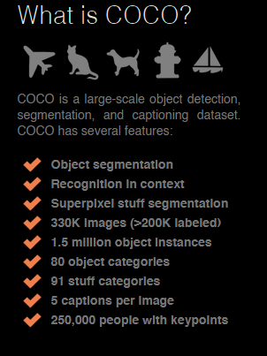


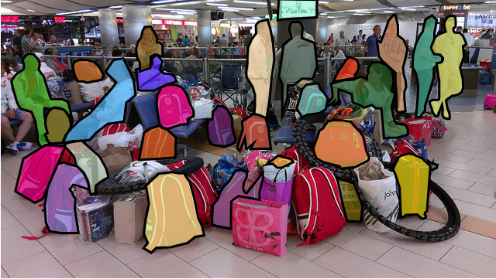
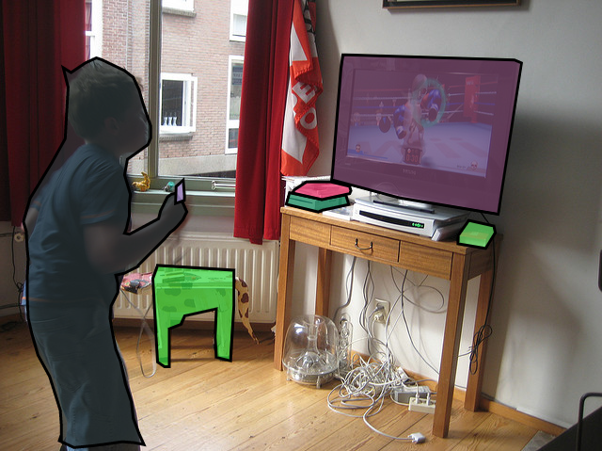
Benchmarking and Competitions
Competition - COCO 2020
Source: https://cocodataset.org/#explore

Slide 22
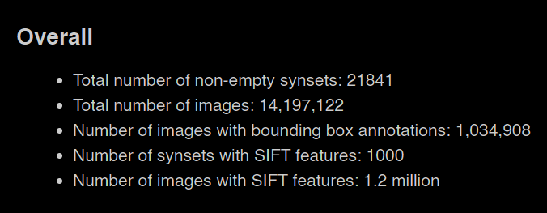
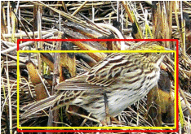
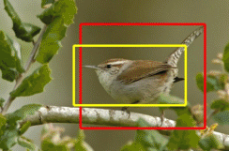
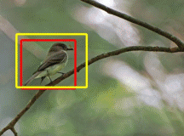
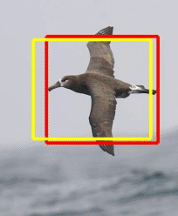
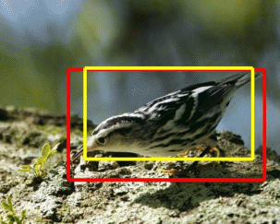
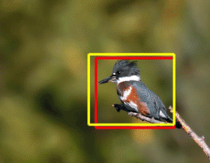
Benchmarking and Competitions
Competition - ImageNet 1000 Class
Problems with ImageNet Dataset
Most of the images consist of only one object and centered to the frame.
More suitable for Classification and Localization task.
1000 Class is not easy to train.
Not used for OD benchmarking.
Bird samples
Source: http://image-net.org/download-bboxes

Slide 23
Benchmarking and Competitions
Combining Dataset for Training
Dataset
Combining Dataset does improve the overall performance
Source: https://arxiv.org/abs/1506.01497

Slide 24
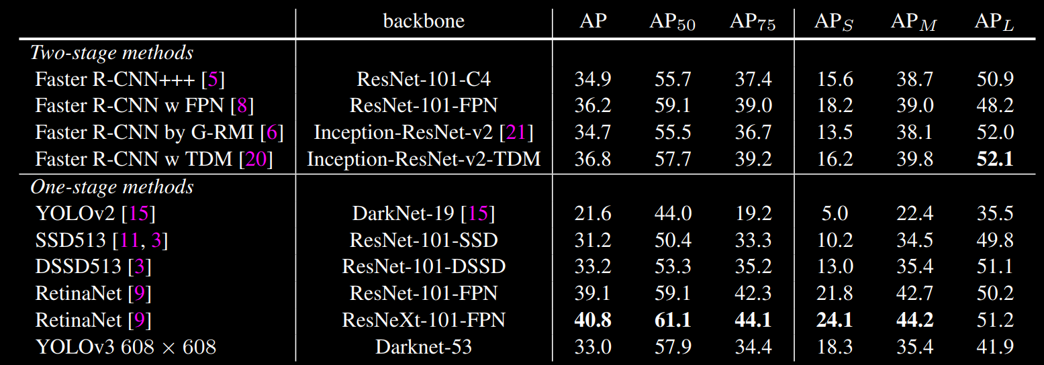
Benchmarking and Competitions
Evaluation For COCO Dataset
AP @
Various IOU thresholds
AP @
Various Size Objects
Source: https://arxiv.org/abs/1804.02767

Slide 25
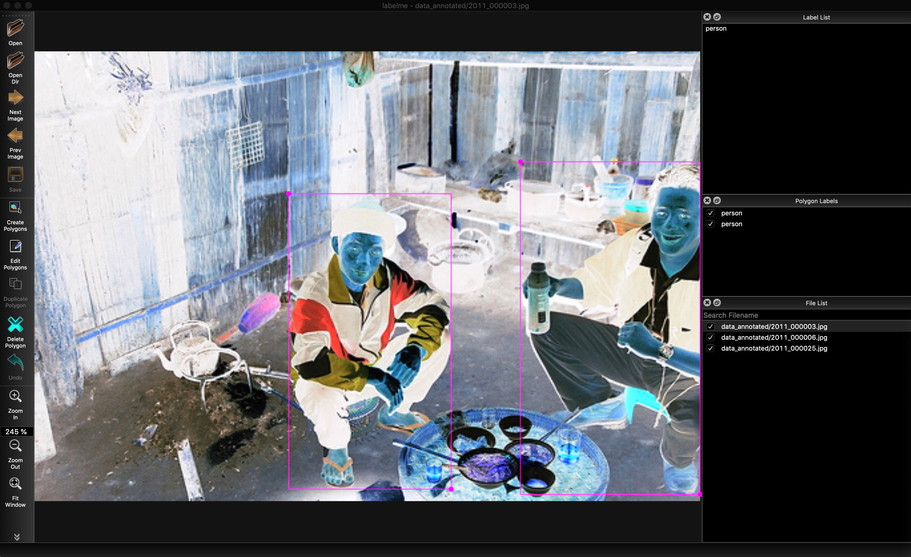
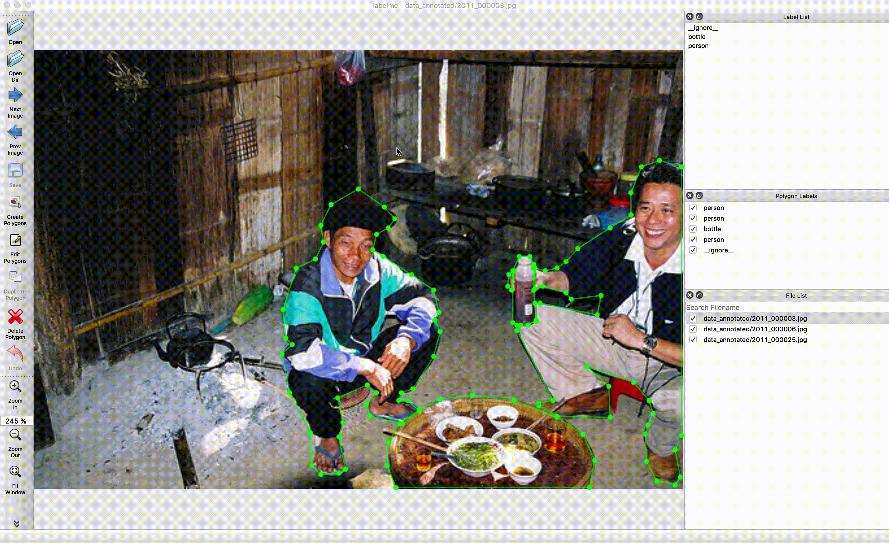
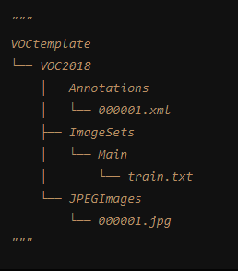
How to create such datasets ?
LabelMe Annotation tool
Source: https://github.com/wkentaro/labelme

Slide 26
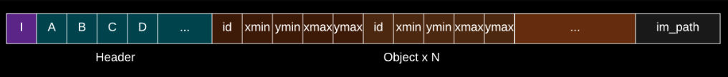
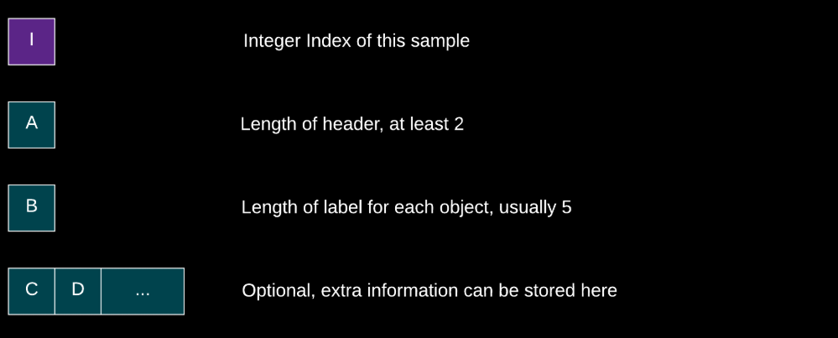
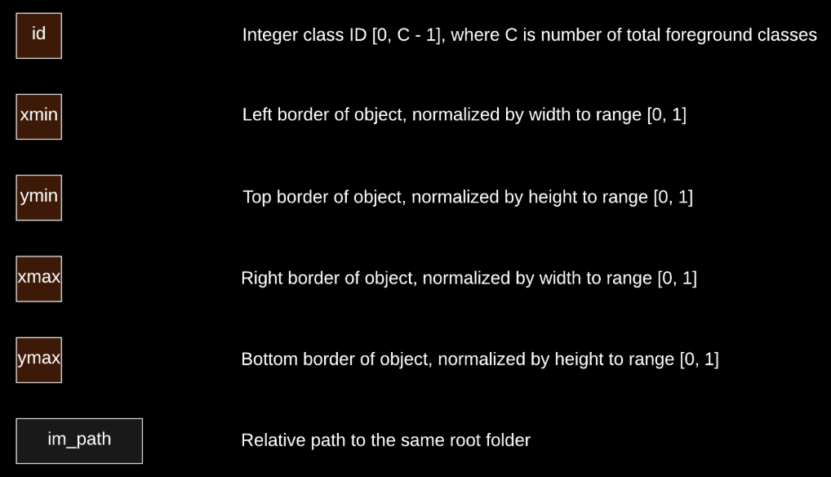
Training Annotation Data Sample
Image Credit: https://gluon-cv.mxnet.io/build/examples_datasets/detection_custom.html

Slide 27



How to create such datasets ?
END ☺

